Slide 1


COMS 6998 Machine Learning & Climate
Predicting CPU and GPU Features for Efficient and Sustainable ML Engineering
Kevin Li
kjl2185

Slide 2

Background
Cost
Performance
Energy Consumption

Slide 3
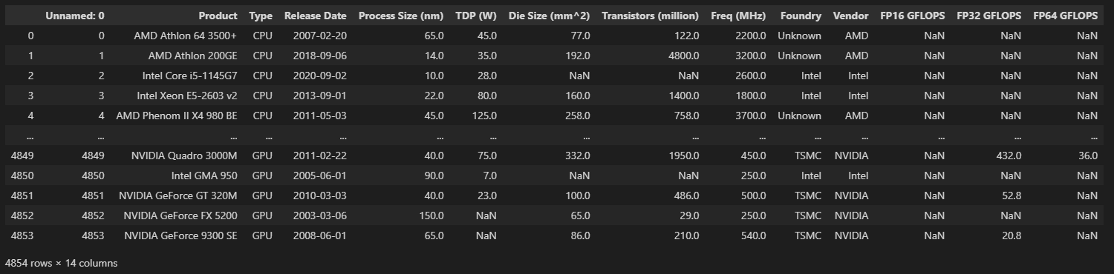
Dataset

Slide 4
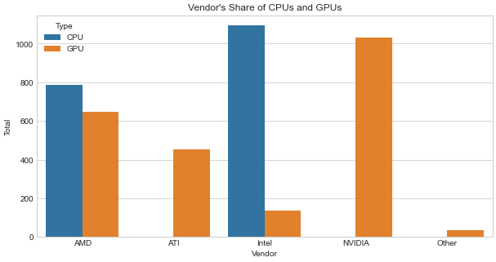
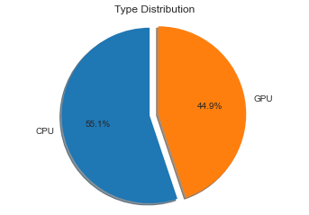
Findings About Dataset

Slide 5
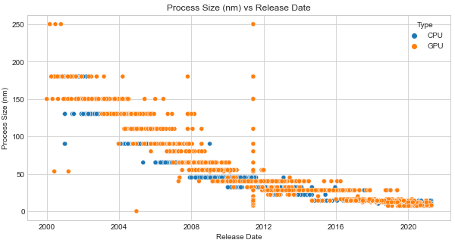
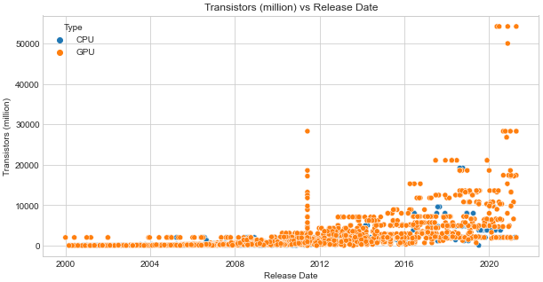
Findings About Dataset

Slide 6
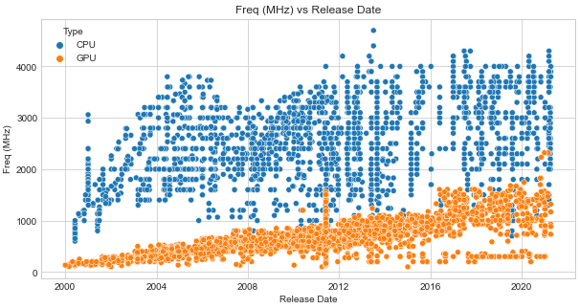
Findings About Dataset

Slide 7





Predicting The Type of Microprocessor Based On Other Features

Slide 8
Thank You!

